Slide 1

22/8/2025
EXCHANGE AND
ALGORITHMIC TRADING –
PART 2: INTRADAY
MARKET ANALYSIS
Chow Chung Yan

Slide 2

COMPARISON SETUP
1. Measurement metrics
Simple data retreival
Aggregate functions (e.g. max)
2. Key comparison
TimeScale DB (with SQLAlchemy) vs MongDB (with pymongo)
3. Variables
*Default : the value of the variable when it is not the variable to be changed
Volume of data extracted/ queried (Default: 1 ticker, 1 field for 1 day)
Number of concurrent users (Default: 1 )
4. Constant setup
Locally hosted database
No other caching or optimizations

Slide 3
COMPARISION METHODOLOGY
1. Latency measurement
Using Python’s time module
Measures the time starting when the query is sent for execution, to when the results are available in memory
This reflects real world usage
Note that the query of the pymongo returns a Cursor object pointing to the actual results, which has to be brought into memory with the list() function. Similarly, the results returned by the SQLAlchemy connection is brought into memory with fetchall()
All tests are conducted locally (not via the API endpoint) to discount the effects of network traffic conditions, which may introduce varying latencies and bottlenecks
2. Concurrency simulation
Using the ThreadPoolExecutor from Python’s concurrency module

Slide 4
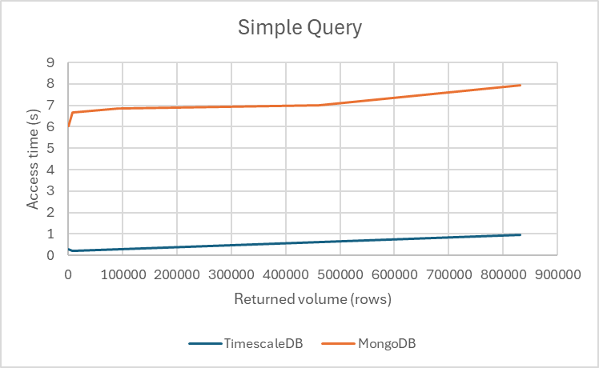
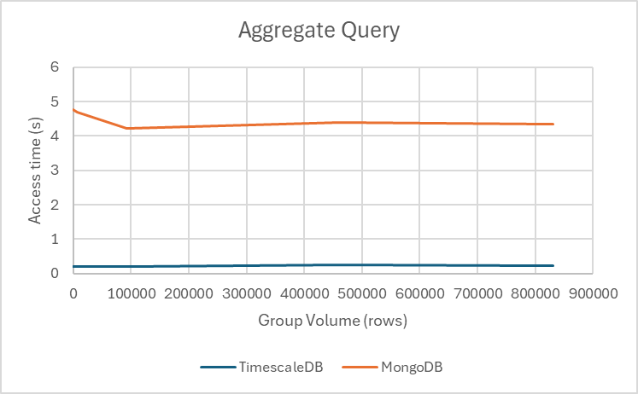
RESULTS - QUERIED VOLUME
Observations:
For both MongoDB and TimescaleDB, the latency scales with the number of rows returned because of the time needed to bring the results into memory. When the number of rows returned in a simple fetching query increases, the latency increases. However, only 1 row is returned for aggregate queries no matter the range of query and therefore access time remains consistent.
Moreover, the list() operation for MongoDB is much less efficient than the fetchall() method provided by SQLAlchemy.

Slide 5
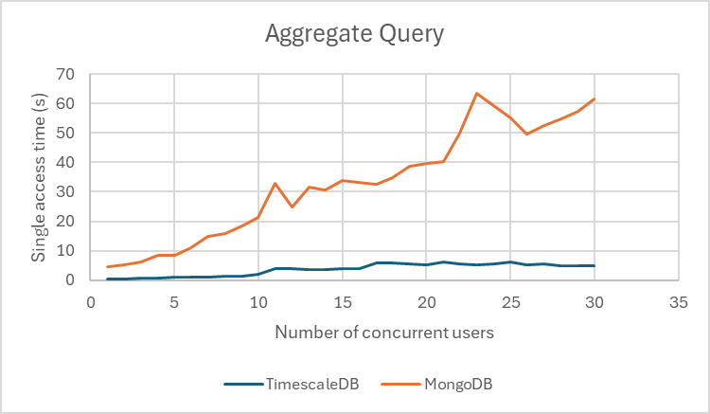
RESULTS - CONCURRENT ACCESS
Observations:
For TimescaleDB, the access time increases in a tier-like behaviour (0 -10, 10-15, 15-30)
For MongoDB, the access time scales linearly with the number of users

Slide 6
COMPARISON CONCLUSION
The inferior performance of MongoDB is not due to the database itself but rather the driver pymongo library. However, in practical scenarios, unless more advanced methods than the list() method is used to bring the query results into memory, MongoDB performs worse overall
TimescaleDB, as a relational database, benefits from the support of SQLAlchemy, which is efficient and gives minimal overhead to the database latency itself
One drawback of using TimescaleDB is the slow data ingestion time, which is more than 10x slower than MongoDB. However, seeding the database is a one-time event and is worth the superior query performance

